Slide 1
Jordan Burroughs Bivariate Poisson Model on Wrestling Matches
Cason Wight

Slide 2
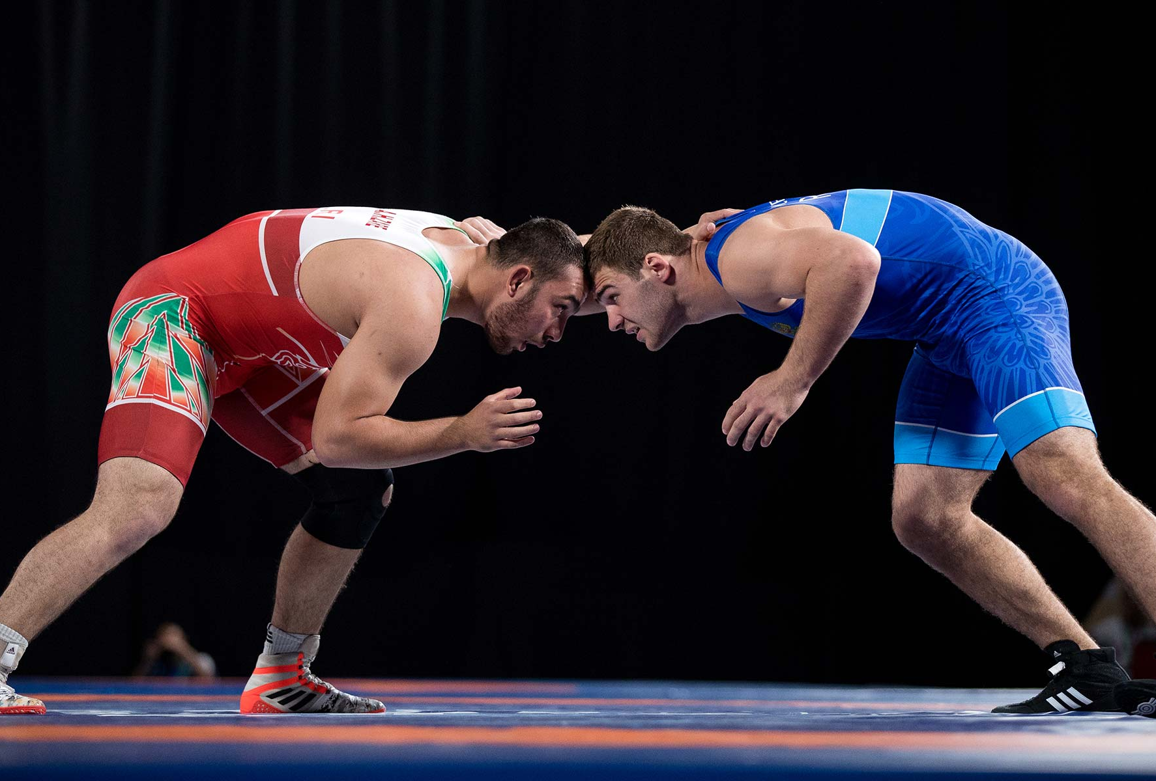
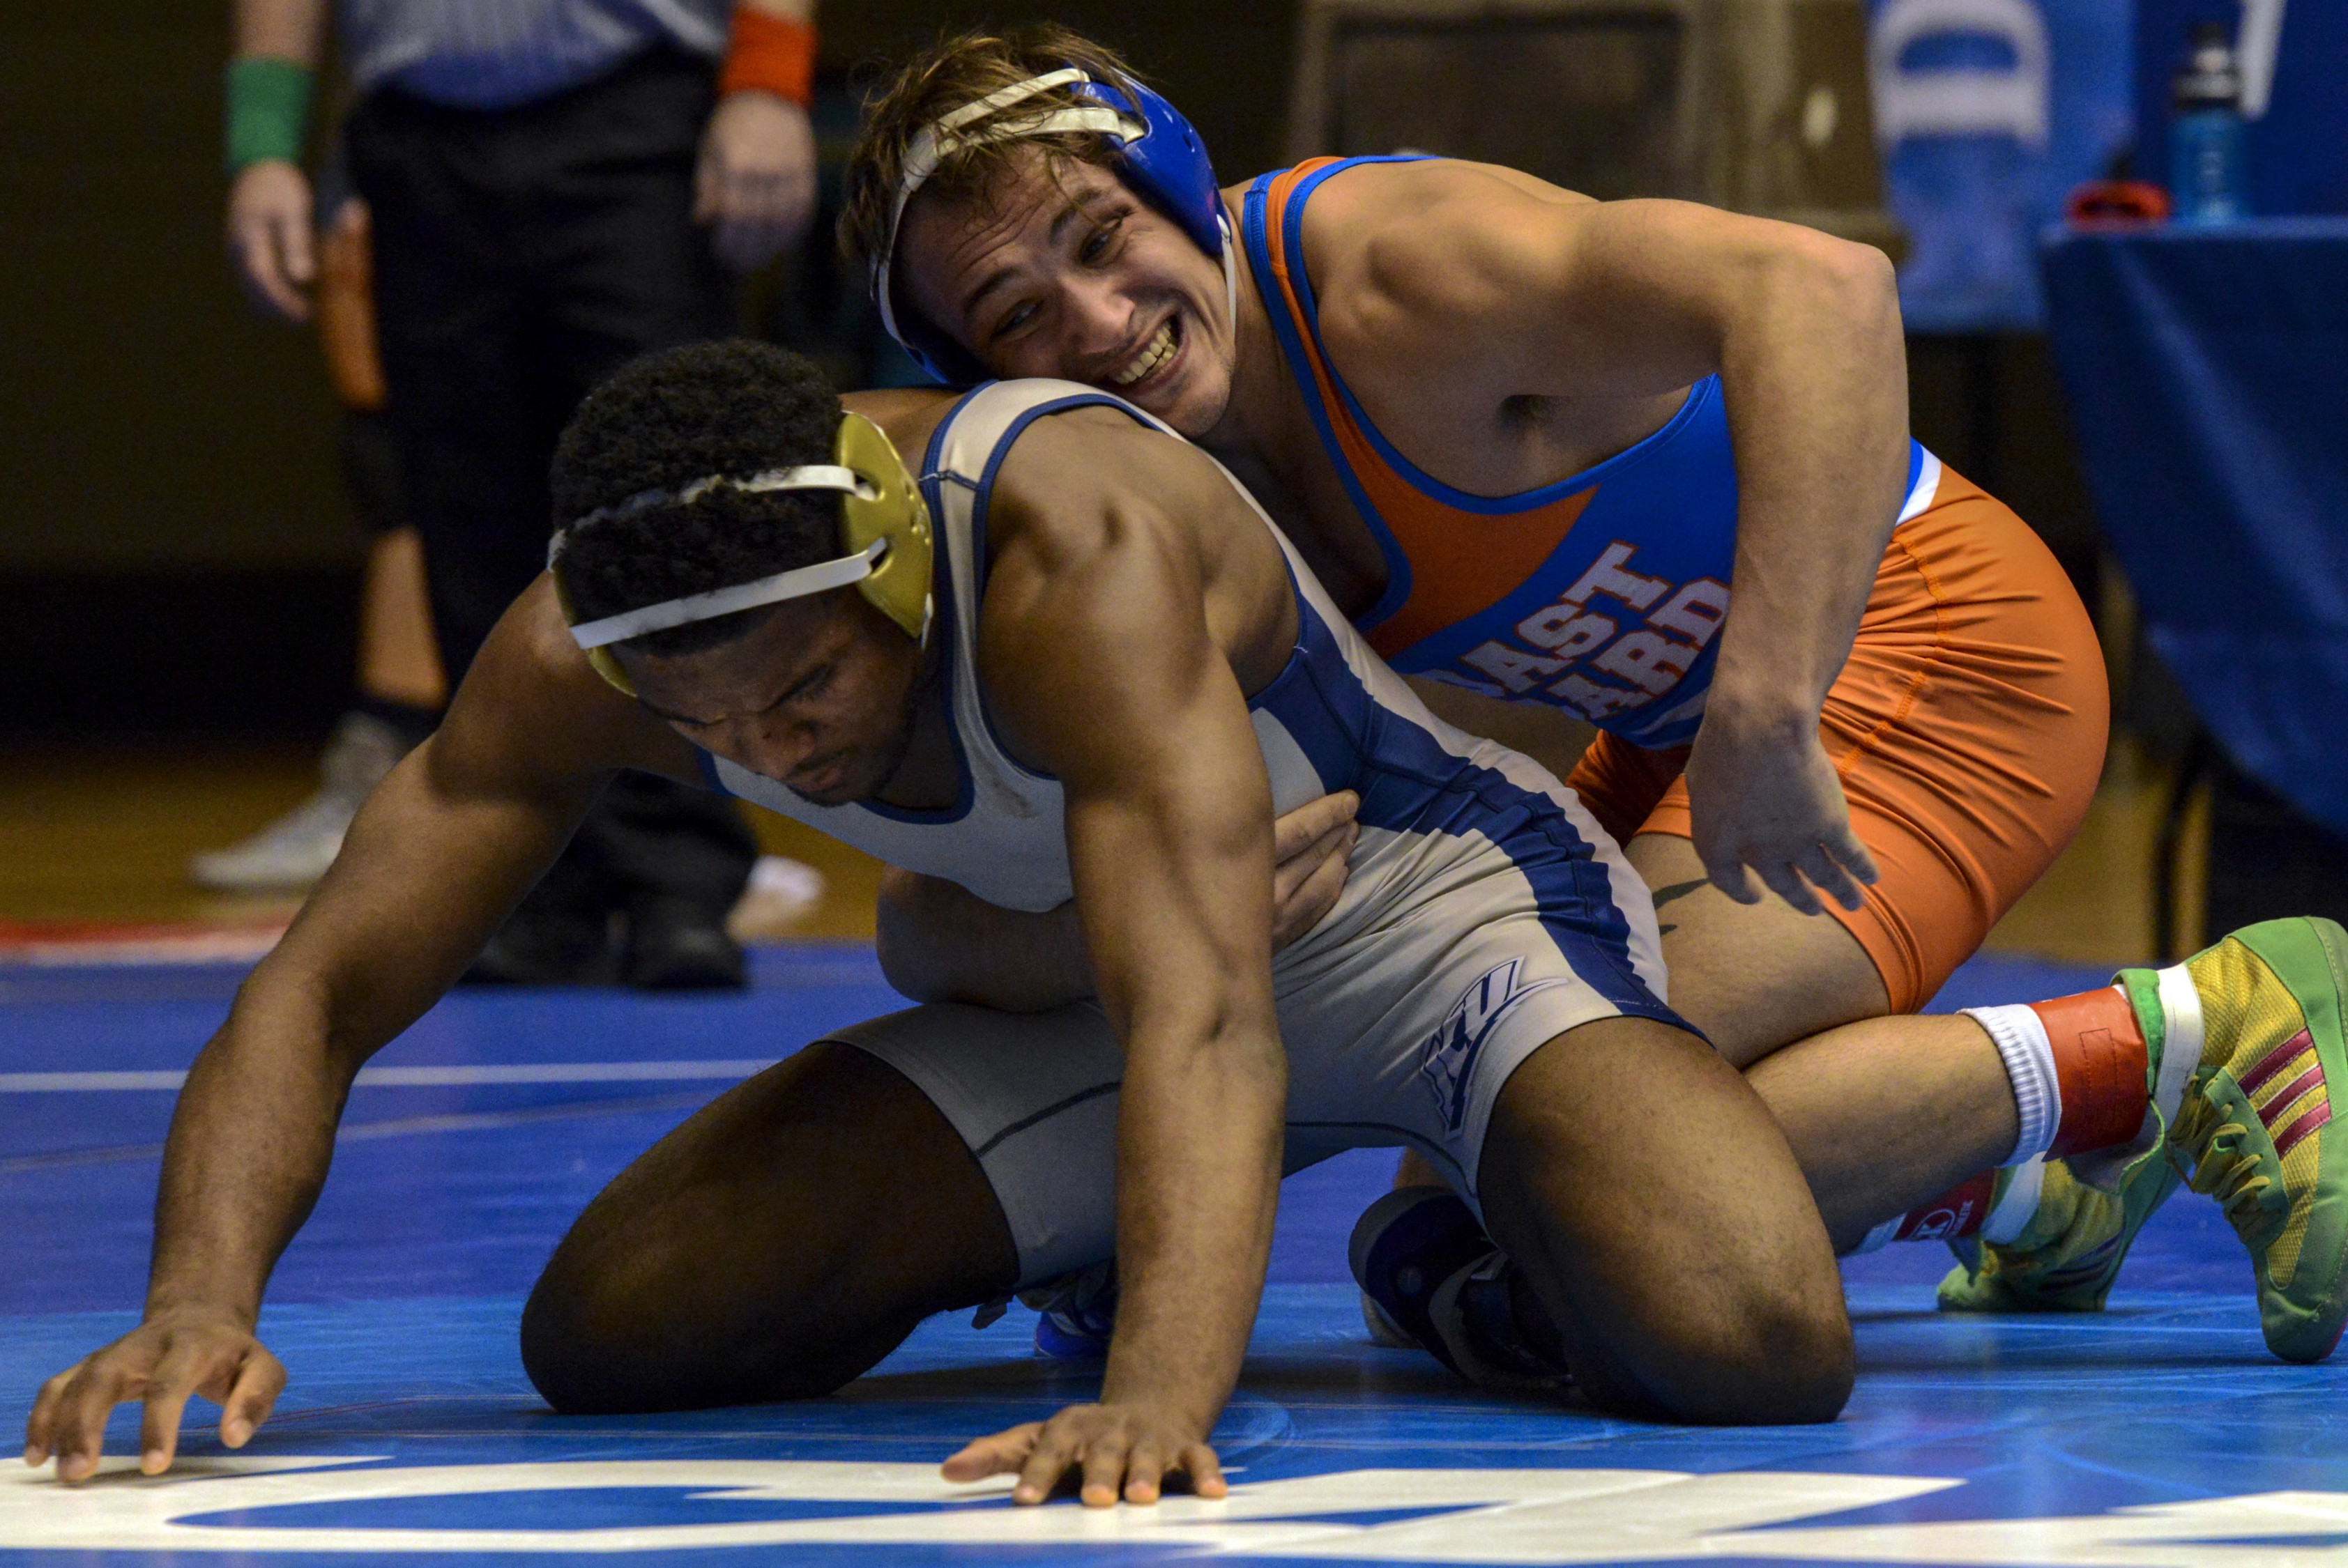
Positions of Wrestling
Neutral
Position
Top/Bottom
Positions

Slide 3
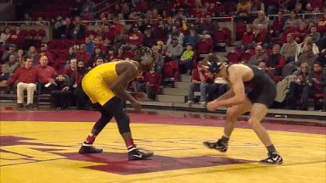
Introduction to Wrestling
Takedown
(2 points)
Neutral --> Top

Slide 4
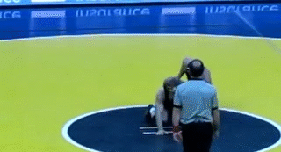
Introduction to Wrestling
Escape
(1 point)
Bottom --> Neutral

Slide 5
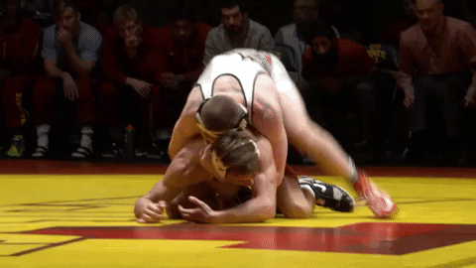
Introduction to Wrestling
Reversal
(2 points)
Bottom --> Top

Slide 6
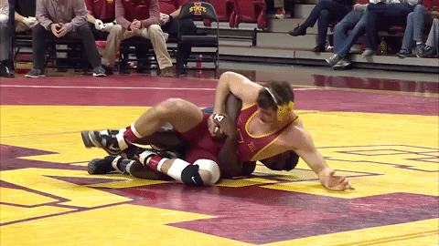
Introduction to Wrestling
Near-fall
(2-3 points)
Put opponent on their back for 2-5 seconds

Slide 7
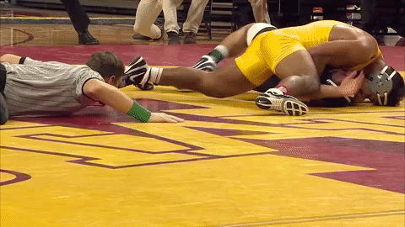
Introduction to Wrestling
Pin
(automatic win)
Plant opponent’s shoulders on the mat

Slide 8
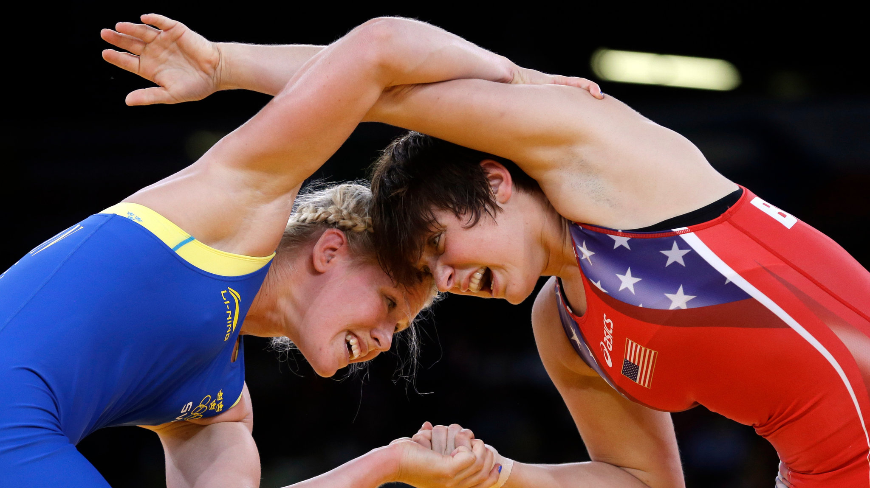
Wrestling on the Comeback
In 2012, wrestling was almost permanently dropped from the Olympics
In recent years, the audience has grown
Exciting matches from people like Burroughs are likely a big factor
Specialty matches and other tournaments boost the fanbase

Slide 9
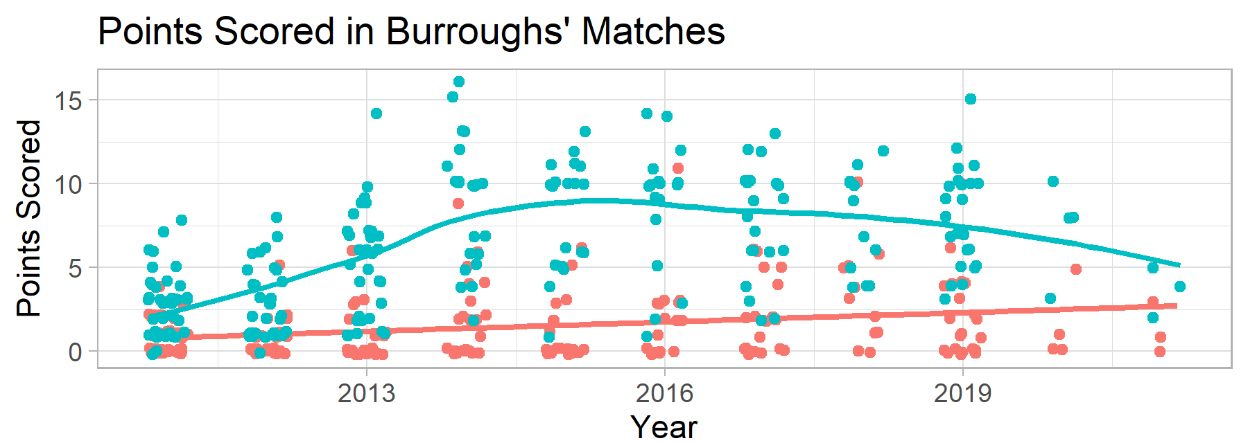
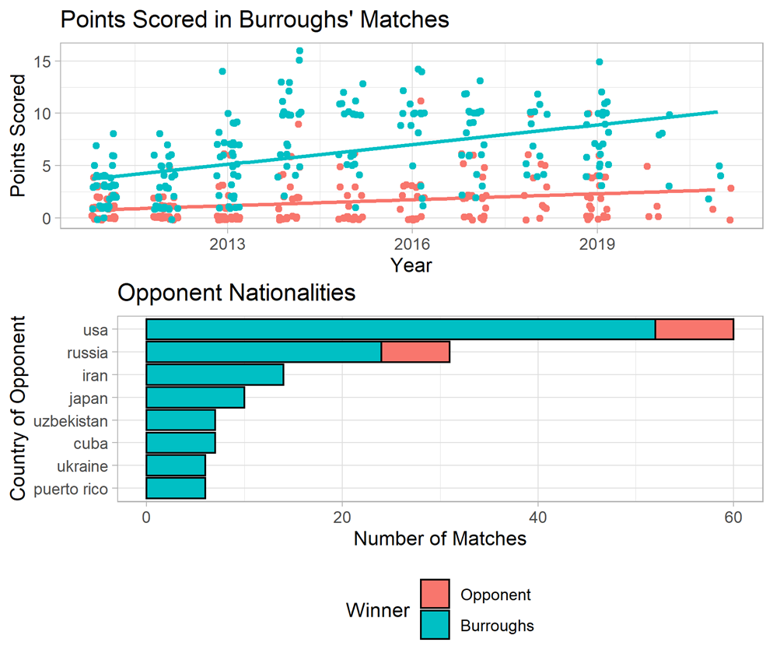
Wrestling Data on Jordan Burroughs https://www.jordanburroughs.com/wins
74 kg. (163 lbs.)
Olympic gold in 2012
5th place at Olympics in 2016
Lost to #1 world seed, Kyle Dake, in Olympic qualifier last week (will not go to Japan)

Slide 10
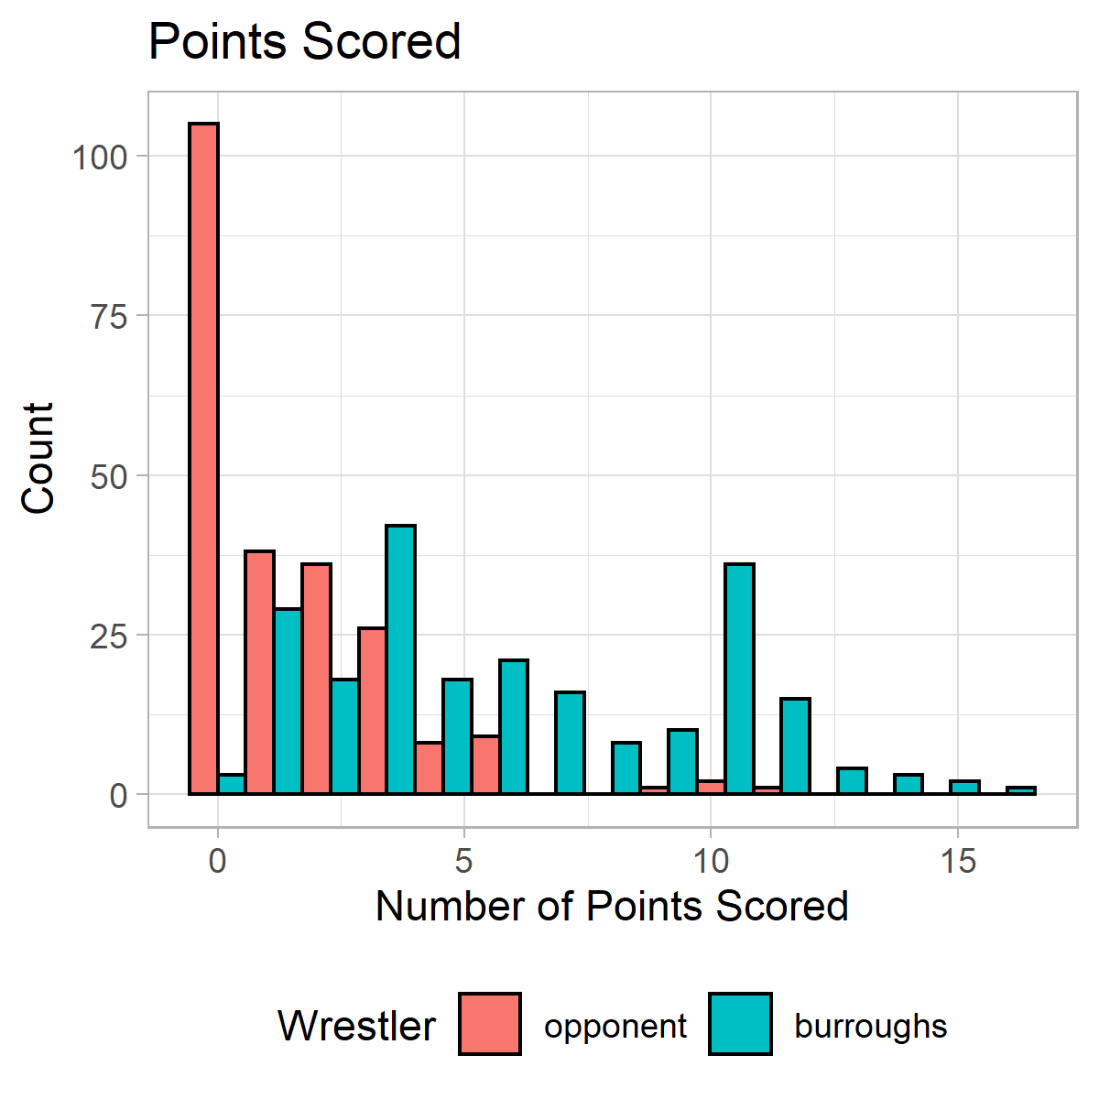
Goals
Model Burroughs’ and opponents’ points
Use Bivariate Poisson GLM (Frequentist and Bayesian)
Identify what might lead to high-scoring matches

Slide 11
Bivariate Poisson Model
$y_{1,i},y_{2,i} \sim Bivariate Poisson\left(λ_{1,i},λ_{2,i},λ_{3,i}\right)$
$y_{1,i}=G_{1,i}+G_{3,i}$
$y_{2,i}=G_{2,i}+G_{3,i}$
$G_{κ,i}\sim Poisson\left(λ_{κ,i}\right)$
$$\log\left(λ_{κ,i}\right)=η_{κ,i}$$
$$η_{κ,i}=x_{i}^{′}β_{κ}$$
$$κ∈\left\{1,2,3\right\}$$
$λ_{i,1}$ is the rate for Burroughs’ points
$λ_{i,2}$ is the rate for his opponents’ points
$λ_{i,3}$ is the *joint rate

Slide 12
Variables included
Year (scaled)
No basis function expansion
Included for $λ_{1i}$, $λ_{2i}$, and $λ_{3i}$
Olympian Opponent (indicator)
2004-2016 at 74 kg.
Olympians rarely change weight classes
Included for $λ_{1i}$ and $λ_{2i}$
Country of Opponent (6 indicators)
USA, RUS, IRA, JAP, UZB, CUB, or other
Other is the baseline category
Included for $λ_{1i}$ and $λ_{2i}$

Slide 13
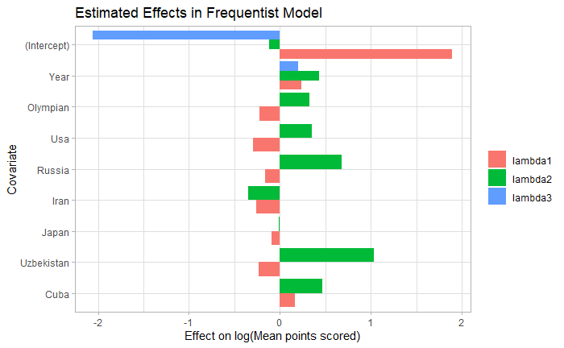
Frequentist Model Results
Notes:
Deviance: 930.21 (better than null and worse than saturated, both with p-values <.0001)
RMSE: 3.35 for Burroughs and 1.89 for Opponent
Due to EM estimation, error bounds not included

Slide 14
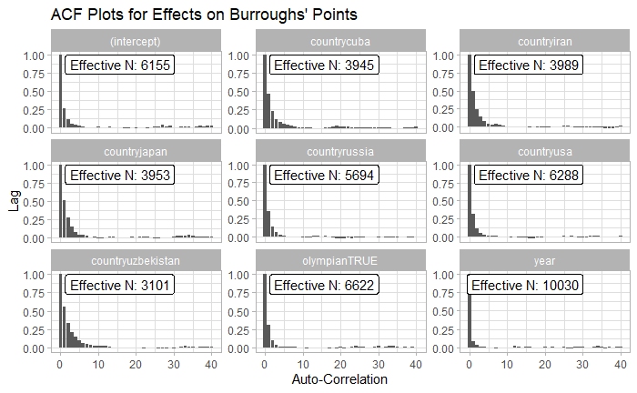
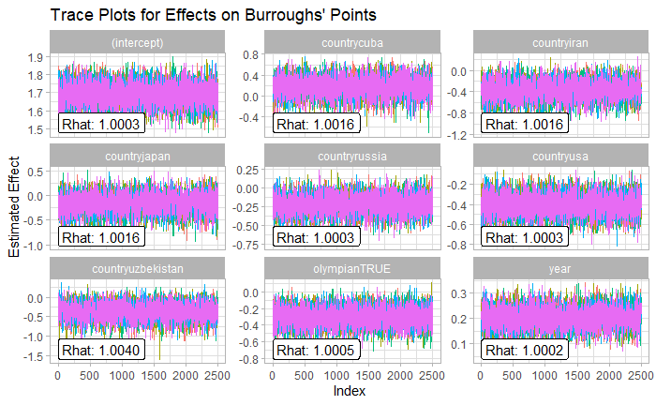
Bayesian Model: Diagnostics
Noninformative prior for all effects, $β_{j,κ}\sim N\left(0,10000\right)$

Slide 15
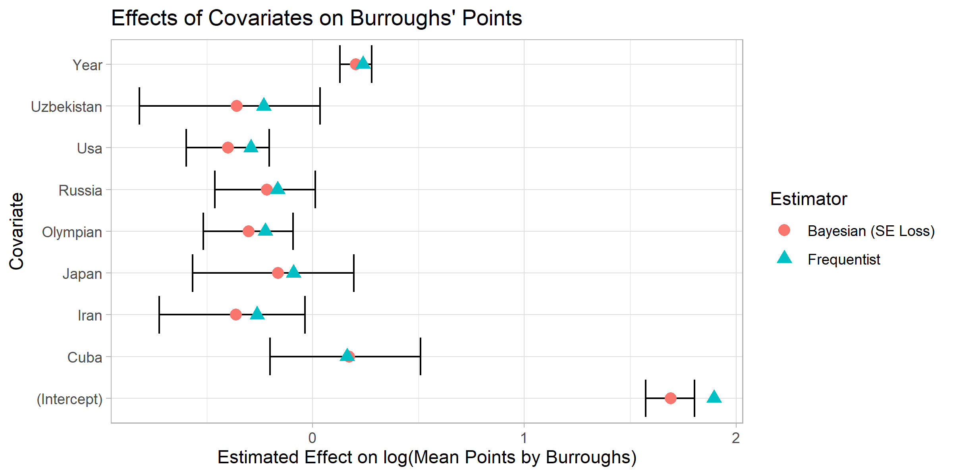
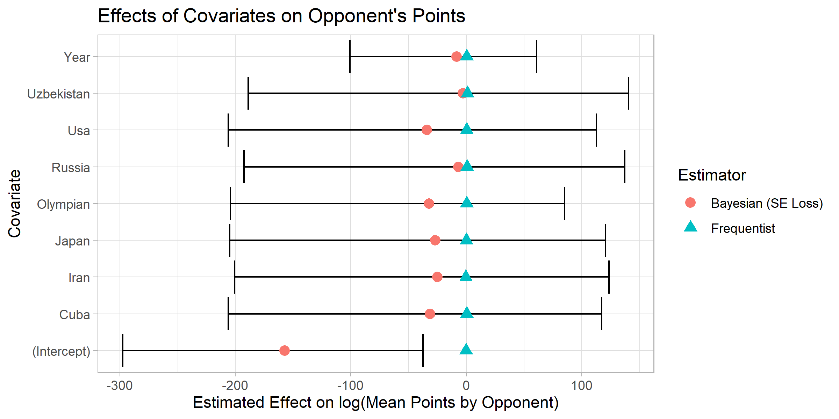
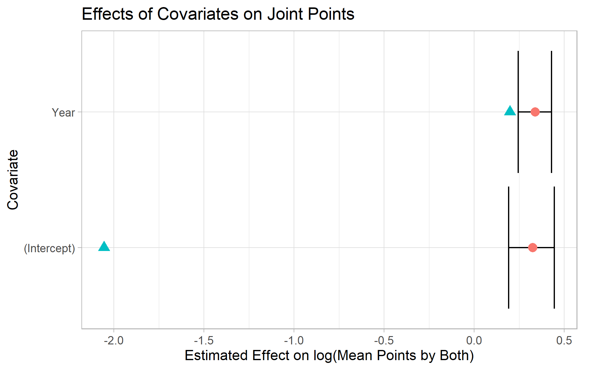
Bayesian Model Results

Slide 16
Model Highlights
Burroughs and his opponents score more over time
CUB score more (and Burroughs more)
Bayesian model essentially always estimates that $λ_{2}≈0$ (puts more weight on $λ_{3}$ than Frequentist does)

Slide 17
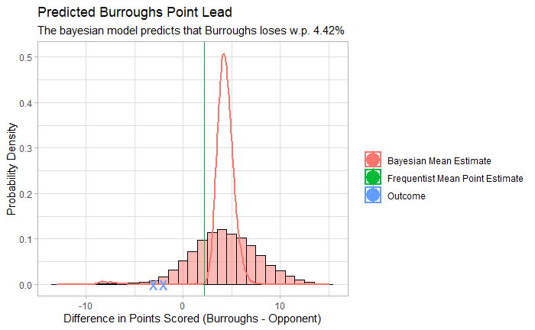
Olympic Trials Prediction: Match Against Kyle Dake

Slide 18
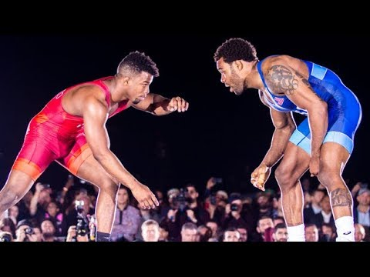
Conclusions/Future Work
For more exciting matches, Burroughs should face experienced, Cuban-style, Olympian wrestlers
Frank Chamizo fits this description
In 2018 “Beat the Streets,” Burroughs won 6-5
In 2021 “Mateo Pellicone,” Burroughs lost 2-3
Pins would be important to model, but are ignored in this project
Modeling wrestler-specific covariates on different matches would give more insights

